Slide 1
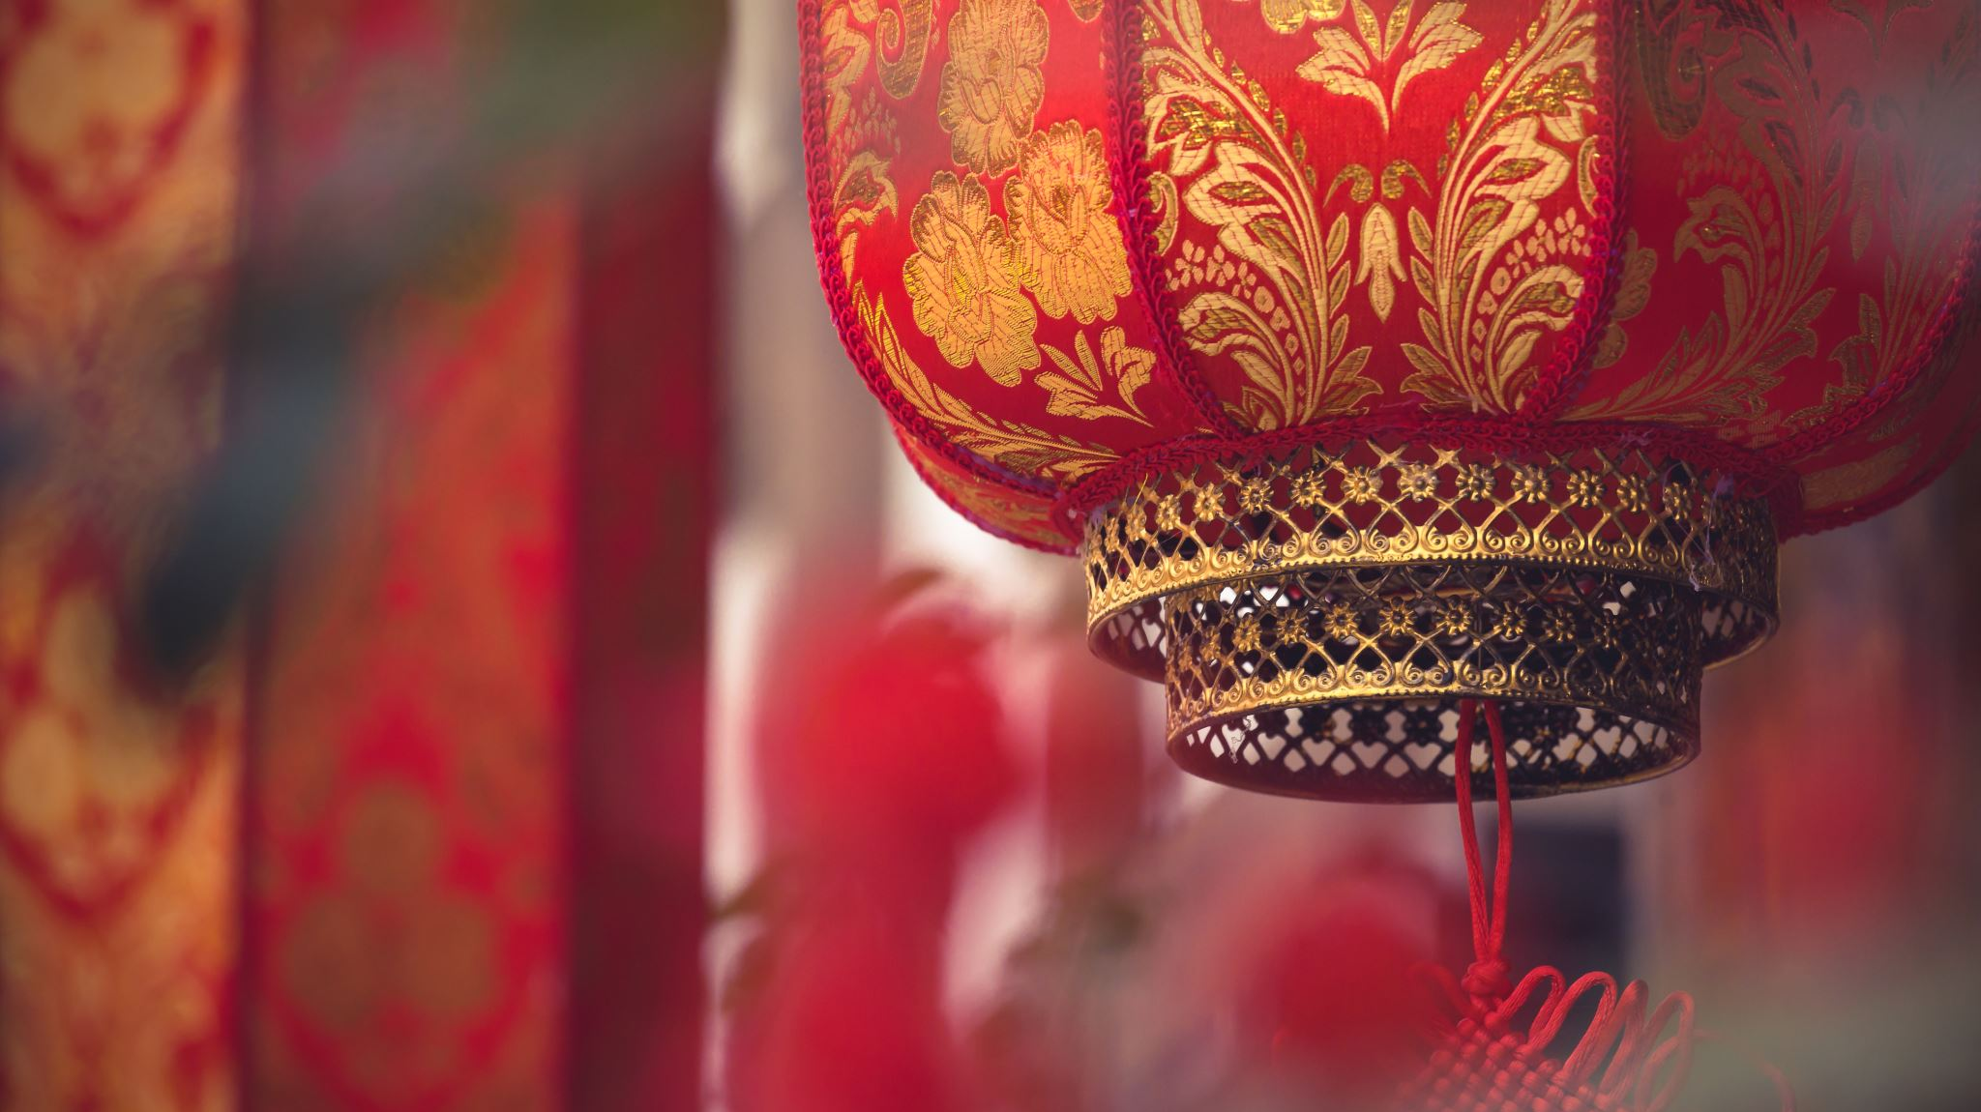
Chinese Valentines Day
The origin of Chinese Valentines Day dates back 2600 years ago. Legends has it that this celebration revolves around two star-crossed
Some Customs of this festival are gift-giving, romantic dates and carving melons

Slide 2
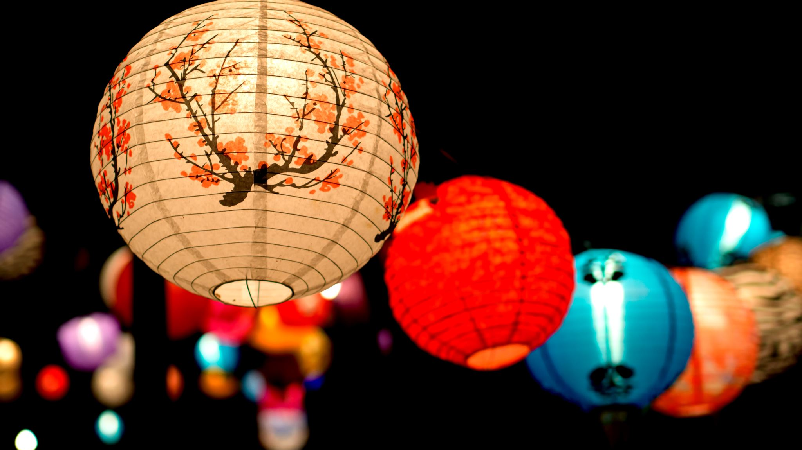
Mid-Autumn Festival
Early record of this festival dates back during Song Dynasty in 920-1279 AD. Legends has it that has roots in the worship of the moon.
Some customs of this festival is Lantern Lighting, Mooncake making and sharing, and Family Gatherings

